Slide 1
4.5 ELECTROCHEMICAL ENERGY CONVERSION
Electrochemical energy conversion is the direct conversion of chemical energy into electrical power or vice versa. A device that converts chemical energy into electric energy is called a fuel cell. A device that accomplishes the inverse conversion (e.g., electrolysis of water into hydrogen and oxygen) may be called a driven cell.

Slide 2
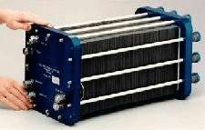
4.5.1 Fuel Cells
A fuel cell is an electrochemical device that converts the chemical energy of a fuel directly into electrical energy.

Slide 3
Basic Parts of Hydrogen – Oxygen fuel cell
A fuel cell is composed of three active components:
a fuel electrode (anode),
an oxidant electrode (cathode), and
an electrolyte sandwiched between them.
The electrodes consist of a porous material that is covered with a layer of catalyst (often platinum in PEMFCs).

Slide 4
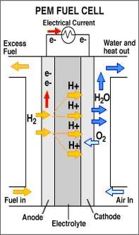
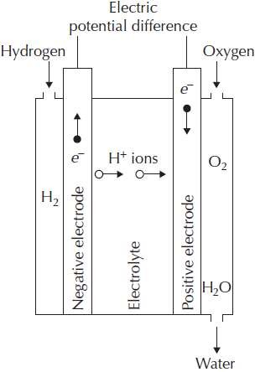


Working Principle of Hydrogen – Oxygen fuel cell

Slide 5
Factors effecting the Power output
In actual fuel cells, a number of factors tend to diminish the power output. They may be expressed in terms of “expenditure” of cell potential fractions on processes not contributing to the external potential,
Δϕext = ϕ −ϕ1 −ϕ2 − ϕ3 − …,
Where each of the terms −ϕi corresponds to a specific loss mechanism. Examples of loss mechanisms are
blocking of pores in the porous electrodes,
internal resistance of the cell (heat loss), and
the build-up of potential barriers at or near the electrolyte–electrode interfaces.

Slide 6
Maximum Power output
These mechanisms limit the reaction rates & tend to place a limit on the current of ions that may flow through the cell.
There will be a limiting current, IL, beyond which it will not be possible to draw any more ions through the electrolyte, because of
Either the finite diffusion constant in the electrolyte, if the ion transport is dominated by diffusion, or
The finite effective surface of the electrodes at which the ions are formed.
It follows that there will be an optimum current, usually lower than IL, for which the power output will be maximal,
Max(E) = I^{opt} Δϕ^{opt}ext

